Slide 1
OBJECT DETECTION AND FOLLOWING ROBOT BY Amreeta Sengupta RIDHI SHAH

Slide 2
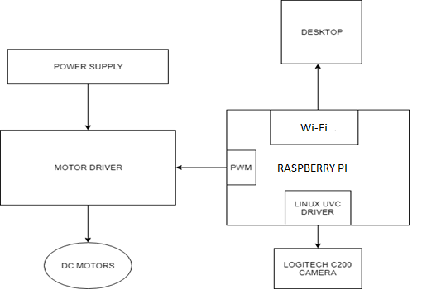
BLOCK DIAGRAM

Slide 3
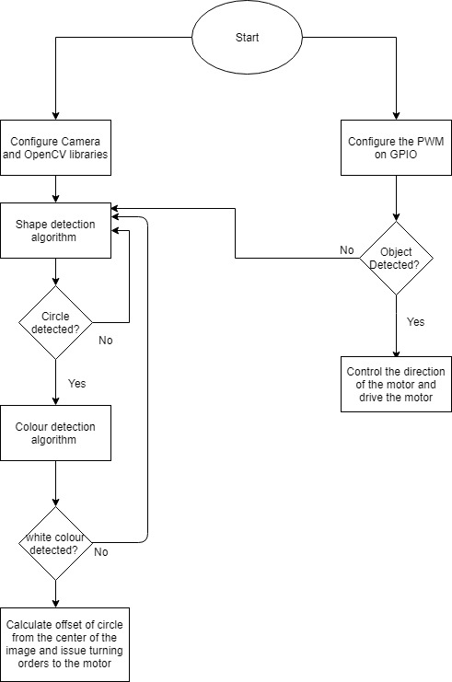
FLOWCHART

Slide 4
CAPABILITY REQUIREMENTS
Shape Detection
Color Detection
Object Tracking
Motor Control
Synchronization between Tasks

Slide 5
REAL TIME REQUIREMENTS
The real-time requirements that we need to meet are executing two tasks without missing the deadlines and protection of the resources shared by the two tasks.
The sequencer task has the highest priority which will enable it to schedule the two tasks accurately.
Image detection and processing task, which executes more frequently, is given higher priority.
The motor control task runs based on the calculations made in the Image processing task and hence is assigned the lowest priority.

Slide 6
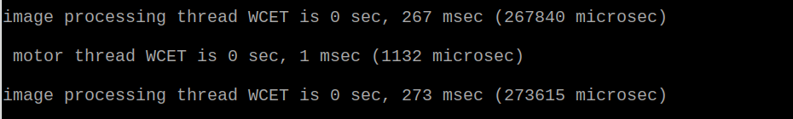
DETERMINATION OF WCET
The WCET for the image processing task was determined by the executing the task individually a number of time in various lighting and angle conditions and determining the maximum execution time.
The WCET for the motor control task was calculated by running the thread multiple times and determining the maximum execution time.

Slide 7
PERFORMANCE REQUIREMENTS
The services are scheduled using Rate Monotonic Scheduling Policy.
The Deadlines have been calculated with an additional safety margin for accurate scheduling of tasks.
The request period for image processing task as 300 ms which will also account for kernel preemption in Linux.
Also, any update in motor control won’t occur until the Image processing task is computed. Thus, request period for motor control task is also set to 300 ms.
Tasks (S_{i}) | T_{i} | WCET (C_{i}) | D_{i}
Image processing | 300 ms | 275 ms | 300 ms
Motor Control | 300 ms | 1 ms | 300 ms

Slide 8
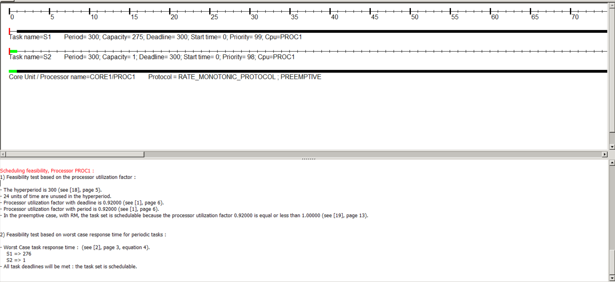
CHEDDAR SCHEDULING

Slide 9
PROOF OF CONCEPT ANALYSIS
PLATFORM USED : RASPBERRY PI
Quad-Core 64-bit processor.
Built in Wi-Fi which we utilized to use the VNC viewer.
Memory : 1GB LPDDR2
Power source: 5V via MicroUSB

Slide 10
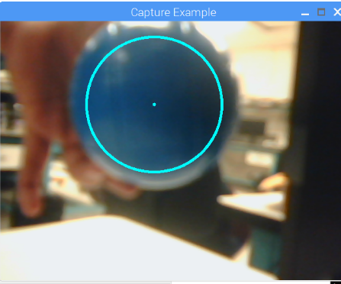
IMPLEMENTATION OF KEY SERVICES
SERVICE 1 : IMAGE PROCESSING TASK
Continuous Capture of Images
Detection of circles in the captured image using Hough Elliptical Algorithm
Detection of a specific color
Calculation of the difference between the Image center and the Center of the circle on detection of object
Determine the direction in which bot moves using the calculated offset value.

Slide 11
SERVICE 2 : MOTOR CONTROL TASK
Control of motor using the calculated offset value
If the calculated offset value is negative, move the bot towards the right
If the calculated offset value is positive, move the bot towards the left
If the calculated offset value is zero, the bot moves in the forward direction in a straight line.

Slide 12
SERVICE 3 : SEQUENCER THREAD
Taking into consideration the WCET of both the task, frequency at which the sequencer runs is calculated.
The sequencer schedules the tasks in the following order:
1) The image processing task
2) The motor control task
This is done by posting the semaphores according to the required frequency.

Slide 13
SYNCHRONIZATION OF TASK AND RESOURCE ANALYSIS
Synchronization of tasks is done by the sequencer thread.
Global flags have been used to share the offset value between the two threads.
This shared resource is protected by using mutex locks to ensure correct value is given to each thread.

Slide 14
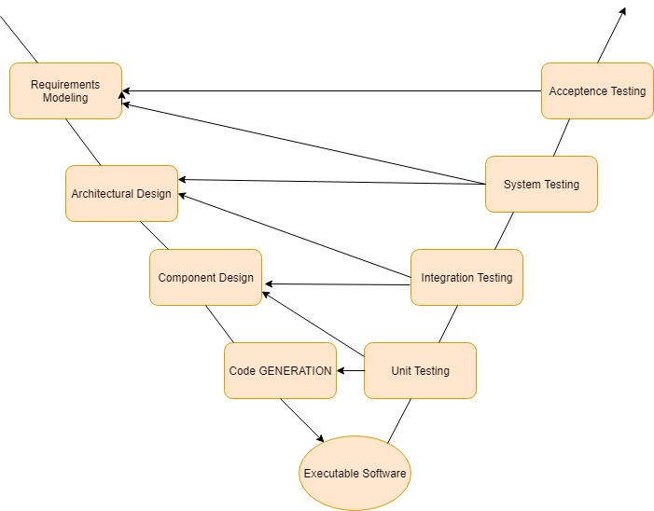
VERIFICATION AND VALIDATION PLANS
Object detection
- Motor Control
-Testing of motor using values calculated by image processing task
-Camera system
-Raspberry PI GPIO
-Image detection testing
-Motor testing
-Code executed using Opencv
-Linux drivers for GPIO and PWM generation for motor

Slide 15
CHALLENGES FACED
The camera gives a very high output latency and a very low FPS which results in delay while detecting the object.
Due to this high latency, the motor cannot be properly synchronized with the detected object and behaves in an unexpected manner.
Owing to the delay in the image detection and processing, even if the position of the object is changed, the motor still executes the task according to the previous image which results in an erroneous output.

Slide 16
THANK YOU

